Slide 1
Arithmetic Instruction
Prepared by:
Priyanka Dobariya 130070107018
Dixita Ganatra 130070107020
Binny Gandhi 130070107021

Slide 2
What is Instruction ?????
An instruction is a binary pattern designed inside a microprocessor to perform a specific function.
8085 has 238 instructions of 74 types.
Each instruction is represented by an 8-bit binary value.

Slide 3
Arithmetic Instruction
Arithmetic instructions perform the operations like:
Addition
Subtraction
Increment
Decrement
For addition and subtraction the quantity is always stored in accumulator.

Slide 4
Mnemonics | Function
ADD REG | Add content of Register to A
ADD M | Add content of Memory to A
ADI DATA | Add the 8 bit immediate DATA to A
ADC REG | Add content of Register and carry(CY) to A
ACI DATA | Add the 8 bit immediate DATA and carry(CY) to A
ADC M | Add content of Memory and carry (CY) to A
DAD Rp | Add the 16-bit contents of the specified register pair to the contents of the HL register and the sum is stored in the HL register.

Slide 5
Mnemonics | Function
SUB R | Subtract content of Register R from A
SUB M | Subtract content of Memory location(M) from A
SBB R | Subtract content of register R and Borrow flag from A
SBB M | Subtract content of memory location (M) and Borrow flag from A
SUI DATA | Subtract 8 bit immediate DATA from A
SBI DATA | Subtract 8 bit immediate DATA and Borrow flag from A

Slide 6
Mnemonics | Function
INR R | Increment content of register by 1
INR M | Increment content of memory location (M) by 1
INX Rp | Increment content of register pair by 1
DCR R | Decrement content of register by 1
DCR M | Decrement content of memory location (M) by 1
DCX Rp | Decrement content of register pair by 1

Slide 7
ADC : Add Register to A with carry
The contents of register/memory and Carry Flag (CY) are added to the contents of accumulator.
The result is stored in accumulator.
The content of the operand are not altered ,but the previous Carry flag is reset.
Flags : All the flags are modified to reflect the result of the addition
Opcode | Operand | Bytes | M-Cycle | T-Cycle
ADC | Reg. | 1 | 1 | 4
 | Mem. | 1 | 2 | 7

Slide 8
Example:
Assume that accumulator contains 50, register C contains 20 and add register C to A.
Instruction: ADC C
Hex code: 89
Addressing mode: Register direct
BEFORE EXECUTION
AFTER EXECUTION
CY | 1
CY | 0
A | 50
A | 71
B |  | C | 20
D |  | E
H |  | L
ADC C
A=A+R+CY
B |  | C | 20
D |  | E
H |  | L

Slide 9
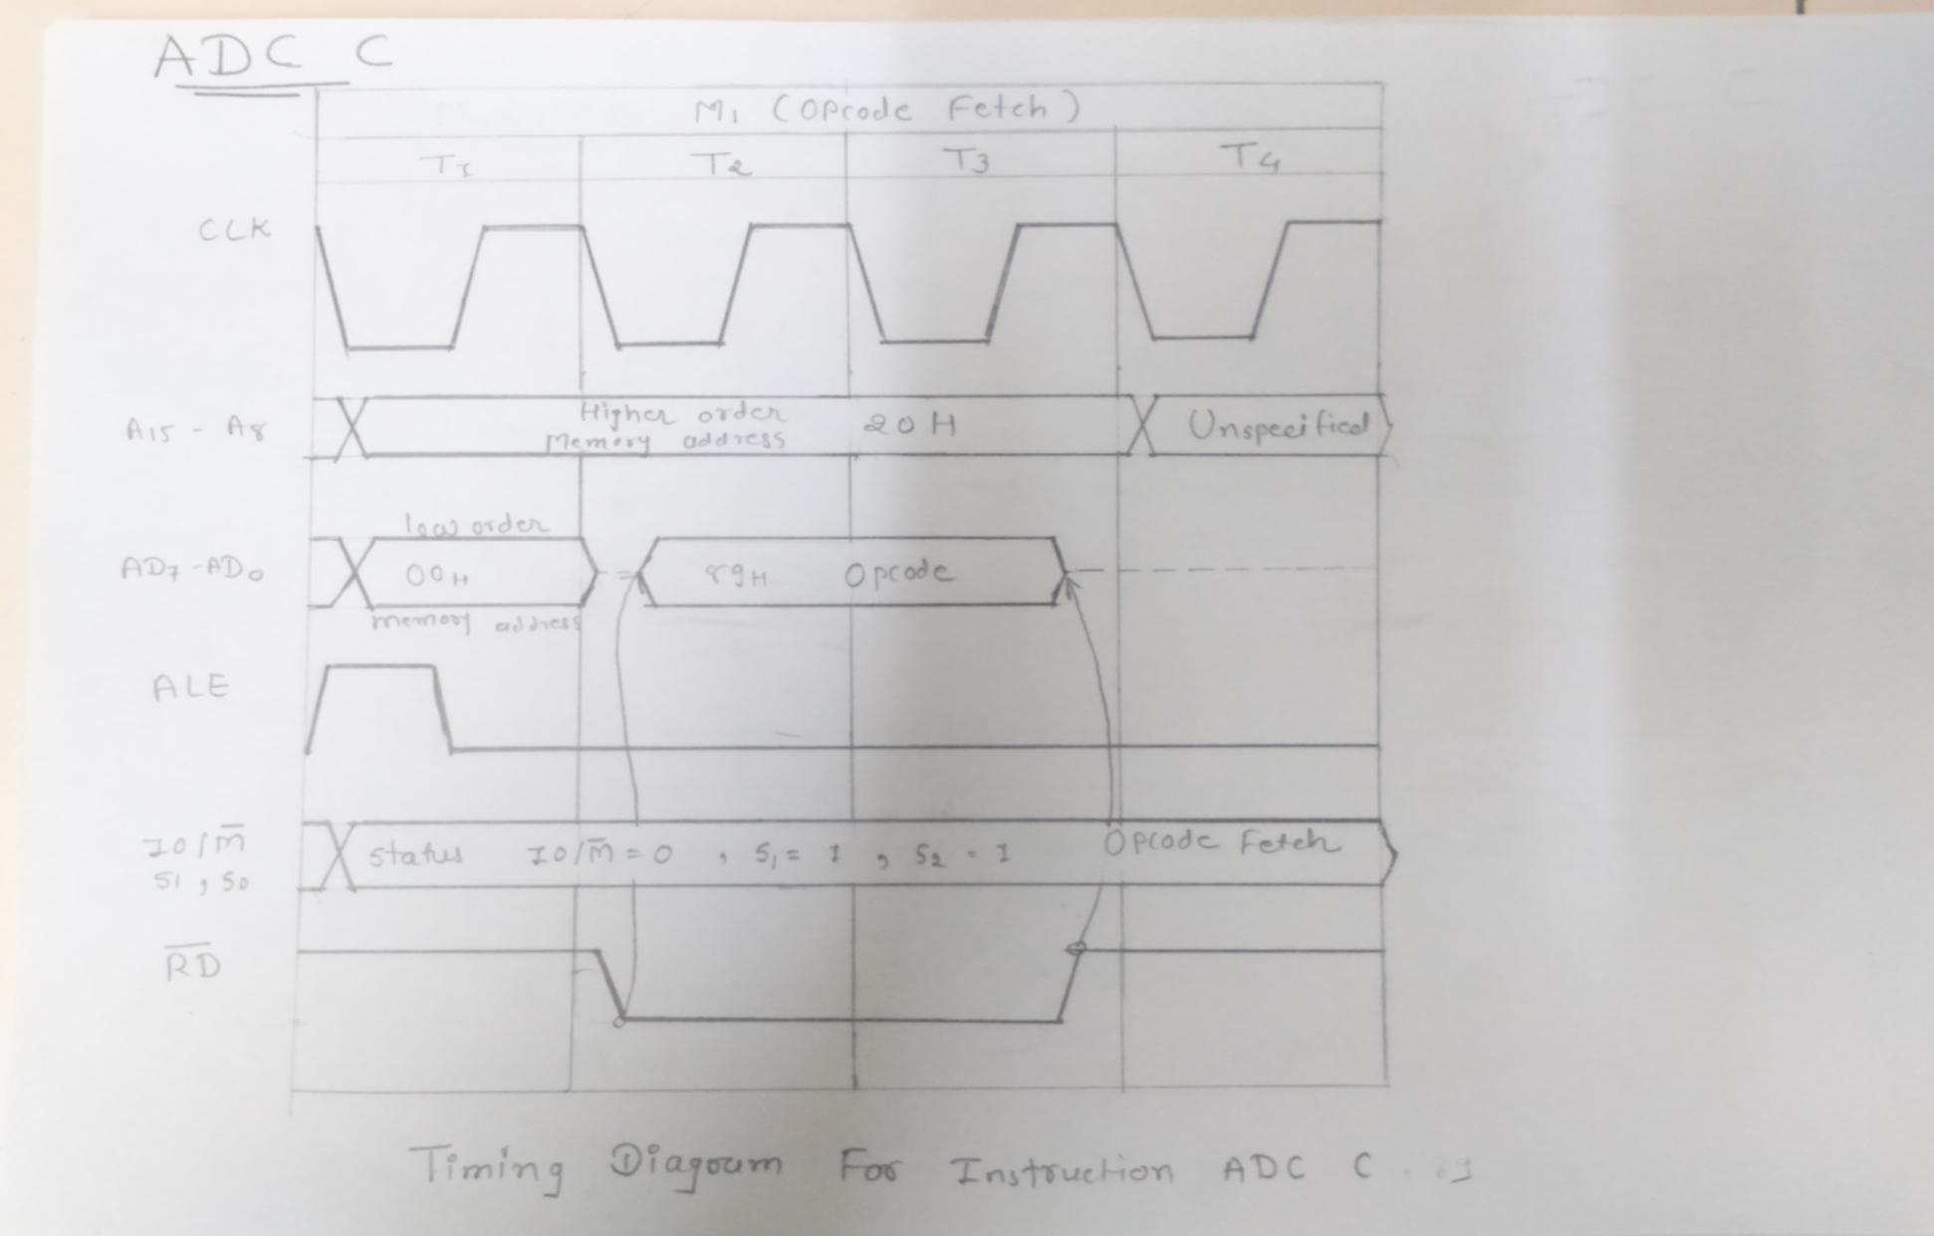
Timing Diagram of ADC R

Slide 10
Example:
Assume that accumulator contains 20 and add the content of memory location 2050 to A.
Instruction: ADC M
Hex code: 8E
Addressing mode: Register indirect
BEFORE EXECUTION
AFTER EXECUTION
CY | 1
ADC M
A=A+M+CY
A | 20
A | 31
B |  | C
D |  | E
H | 20 | L | 50
B |  | C
D |  | E
H | 20 | L | 50
10
10
2050
2050

Slide 11
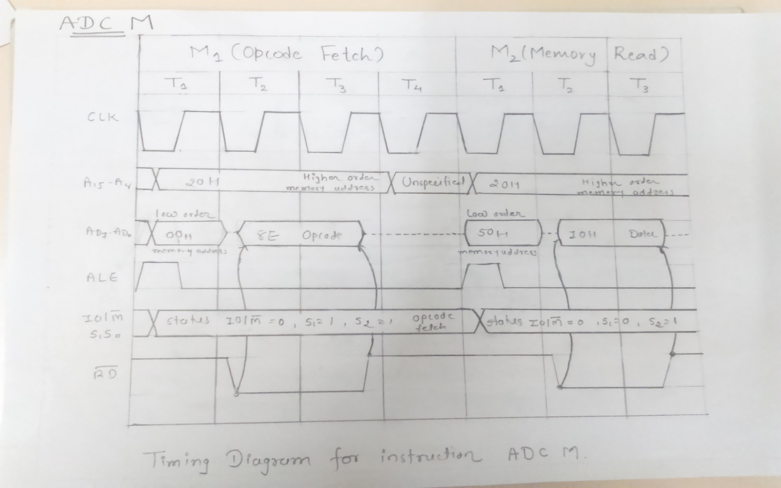
Timing Diagram of ADC M

Slide 12
INR :Increment Content of Register/Memory by 1
The contents of register/memory are incremented by 1.
The result is stored in the same place.
If the operand is a memory location , it is specified by the content of HL register pair.
Flags: S,Z,P,AC are modified to reflect the result of the operation. CY is not modified.
Opcode | Operand | Bytes | M-Cycle | T-Cycle
INR | Reg. | 1 | 1 | 4
 | Mem. | 1 | 3 | 10

Slide 13
Example :
Increment the contents of the memory location 2050H, which presently holds 30.Assume the HL register contains 2050H.
Instruction code: INR M
Hex code: 34
Addressing mode : Register indirect
BEFORE EXECUTION
AFTER EXECUTION
30
31
H | 20 | L | 50
H | 20 | L | 50
2050H
2050H
INR M
M=M+1

Slide 14
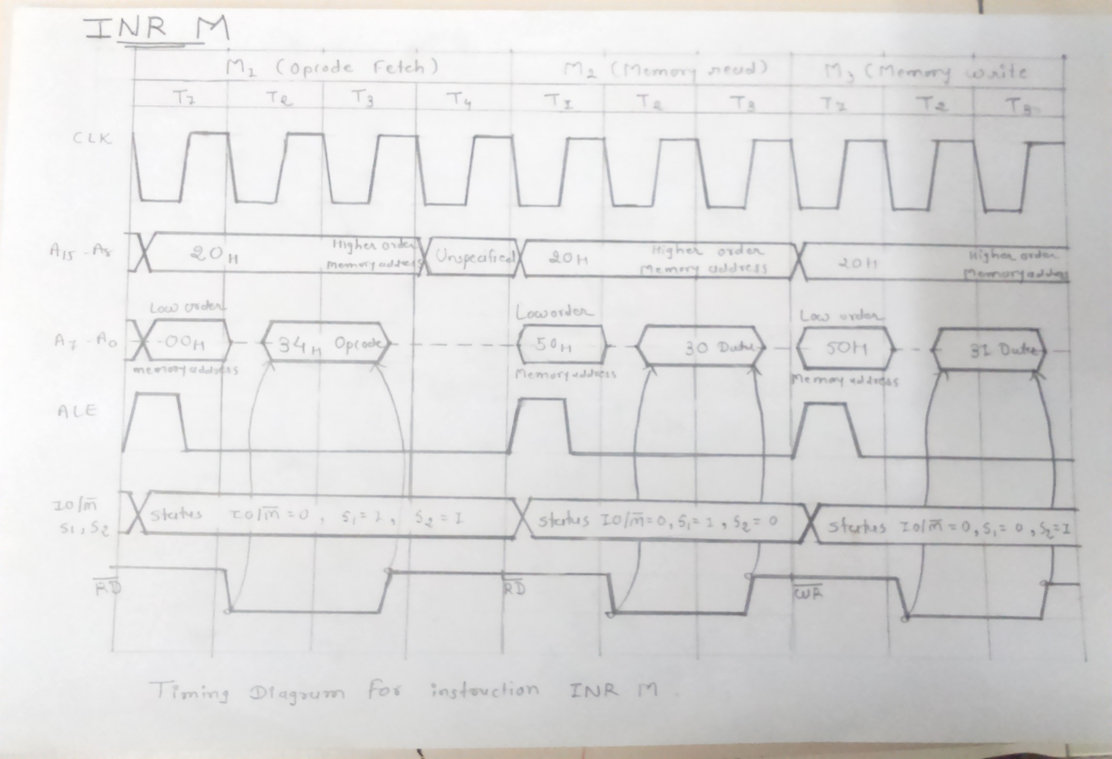
Timing Diagram of INR M

Slide 15
THANK YOU...

